Slide 1
MY MIGRATION IN GERMANY

Slide 2
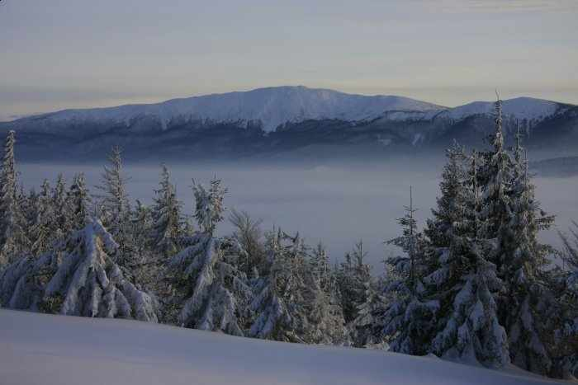
My name is Jolanta Trzebuniak and I come from Poland. I live in the mountain resort, Zawoja, situated in the Beskid Mountains.

Slide 3
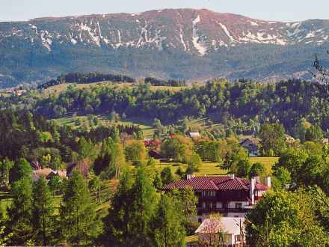

Slide 4
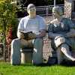
I have lived in Germany for about 1,5 year time, I worked in Rheda-Wiedenbruck, in the area of Luxembourg, in Cologne, Wiesbaden and Freiburg. I left in order to earn money. Through these leaves also could many interesting places such as the Cathedral in Cologne, and beautiful Renaissance great churches and museums. And I must say that you can come to Germany as a tourist and visit this beautiful country.

Slide 5
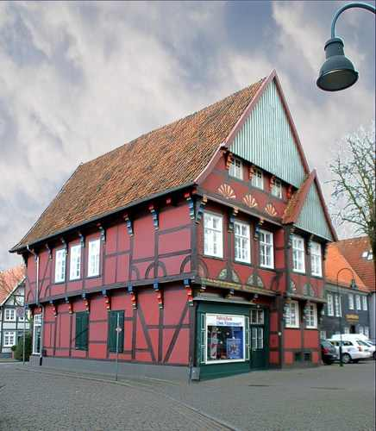

Slide 6
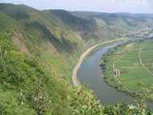

Slide 7
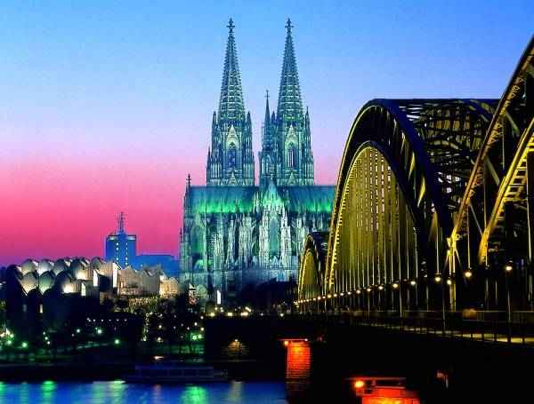

Slide 8
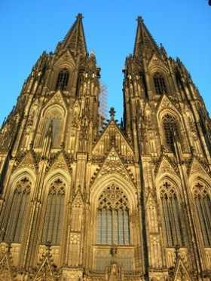

Slide 9
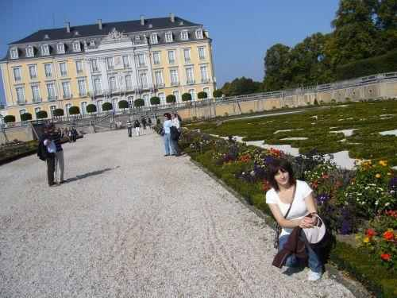

Slide 10
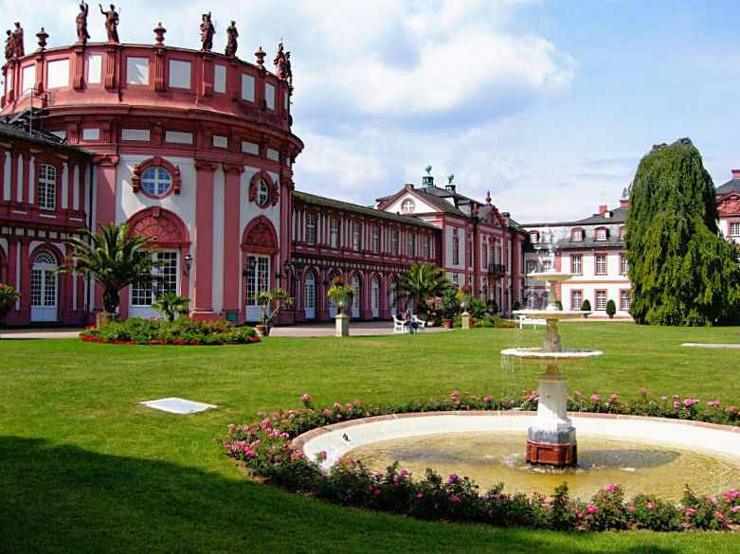

Slide 11
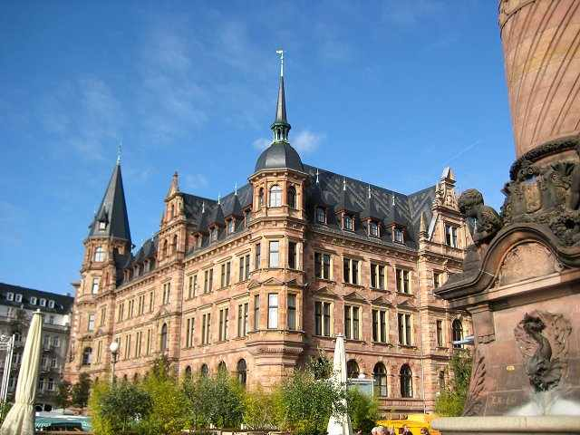

Slide 12
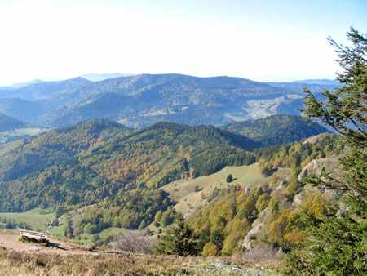

Slide 13
Moreover after the arrival to Germany I was able to buy a car and pay for college. The biggest barrier after my arrival to Germany was the language. I had studied German in Poland, for about 4 years, but at school it sounded a little differently, each word was separate, clearly spoken. However, it appeared that the Germans speak very quickly, with a different kinds of accent and words merge into one continious chain. Only after two days I began to distinguish individual words in these statements and understood the context. Moreover, in everyday language are used a number of words that are not taught in science Hochdeutsch (the official German language). Additionally, for example, in the vicinity of Luxembourg or the Black Forest I came into contact with dialects, which also made communication difficult to me. However, after this first period, I must say that living in Germany is very different from the reality of Polish salaries. In Germany salaries are too or three times higher than in Poland, and prices for food, clothing, or the media are relatively on the same level, as in our country. In Germany, I was surprised by the diversity of cultures that mix in this country. In Poland live mainly Poles. We all like to dress and speak the same language and more then 90 % profess the same religion, Catholicism. According to the fact that salary level in Germany is so high, attracts Poles, Russians, Turks, Italians, Gypsies, Africans, Argentines, Chinese to come to earn money. On the streets of Cologne, for example, it is normal to meet a woman dressed in Muslim attire, an African man dressed in a tunic.

Slide 14
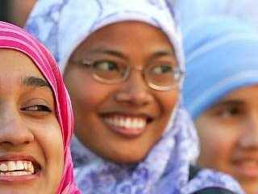

Slide 15
The largest group among foreigners, 1,7 million people, are Turkish, on the second place are the Italians (530 thousand). Therefore, prior to German politics and society is put the challenge of immigrants of integration. The hardest thing is to integrate people of different religion, especially Islam and those who do not know the German language and deploy them to the labor market so there they wiil not be a social burden to the community, but to assist them in the creation of the domestic product. My friend, Beatrice, got married to Italian and now they have 4-year-old child, with whom they speak in Polish, Italian and German at home, but his level of German may be too weak to have found in a peer group and functioned well at school. Unfortunately, this is a very common problem of children from immigrant families. Beatrice said that didn’t want her child was pointing the finger at school and, therefor, decided to hire a German babysitter and asked her to talk to a child as much as it is possible. However, not all parents are so resourceful and caring, a lot of people come from countries with much lower levels of development, such as Romania or Africa, and if they did not help the German state, unfortunately, this can cause a lot of social pathology among adolescent foreign language youth. In Germany, it is expected in the near future network of caregivers who are helping children and young people from immigrant families in school and during training. The area of Germany, is inhabited by about 82 million population, including only 1/5 in eastern Germany, on the territory of the former GDR. It is easy to see when coming to Germany, that in a society dominated quantitatively elder group. I could see this on the street, on trams, shops. A lot of old people are disabled and move by using special walkers and wheelchairs. In addition, there is a problem of very low birth rates. It prolonged the life expectancy , for males the average is about 77 years for women is over 82 years. In Germany are born twins quite often and many women have their first and often only child until the age of 40. I think it is mostly the question in vitro. Furthermore, in Germany, abortion is legal and is not generally viewed negatively if the woman who doesn’t want children and remove the pregnancy. Since 1975 the birth rate of children per woman is approximately 1,3. Many women in Germany wish too put the career and professional development bevor and put motherhood on the last. Also a lot of people do not want to have a children. There is a group of society which prefer to have a dog and don’t want to complicate their lives and assume full family. While I was in Germany, I have met with the 80-year old German woman’s statement: “I didn’t ever want to have children, they always annoyed me, and I would have never resigned of my work; my husband was always enough for me” However, you should not portray the image of the German society as a whole, on the base of one statement. There are ordinary families, which are very in love and they have one, two, and sometimes even more children. Generally one can say that German children are more well-groomed than Polish, and usually the parents care about the good, based on trust relationships with children. At present, young people live a little longer with their parents, which is losed by the fact that more and more people take up studys in college.

Slide 16
However, you should not portray the image of the German society as a whole, on the base of one statement. There are ordinary families, which are very in love and they have one, two, and sometimes even more children. Generally one can say that German children are more well-groomed than Polish, and usually the parents care about the good, based on trust relationships with children. At present, young people live a little longer with their parents, which is losed by the fact that more and more people take up studys in college. Generally speaking, Germany is open to different cultures and nations, but it does not mean that this applies to the whole society and that their presence does not cosed any conflicts. When I stayed in Cologne in 2008, there was planed a European summit which was held by parties which opposed to the Islamisation of Europe. The event never took place because of leftist militans in the name of tolerance, threw stones at opponents and the German authorities have condemned the organizers of the summit. I got to know that in Cologne fierce confrontation between opponents and supporters of building a huge mosque with minarets 55 meters height have been continued for several years. In the Pro Kőln organization tried to prevent it, in spite of having almost all the political forces in the city against. According to the media, Pro Kőln is an organization extreme right-wing, xenophobic and racist. However, the organization states that it only wants to highlight the danger of being submisive to the expansion of Islam. Broken windows, burned rubbish containers, crippled communications throughout the region of Cologne - were the results of two days protest of leftist groups in Cologne against the congress organized by the organization Pro Kőln. Several policeman were injured. Have a thousand demonstrators from leftist and anarchist circles were also rainded arrested custody, were several particularly violent protesters. Their behavior condemned Fritz Schramm (CDU), the mayor of Cologne, who appeared at a rally against the initiative Pro Kőln. Tens of thousands of opponents of the congress took possession of almost the entire Cologne. The access to Heumarkt was defended overnight from Friday to Saturday. They tried to get warmer at the burning containers, keeping banners with said; “Down with the Nazis”.

Slide 17
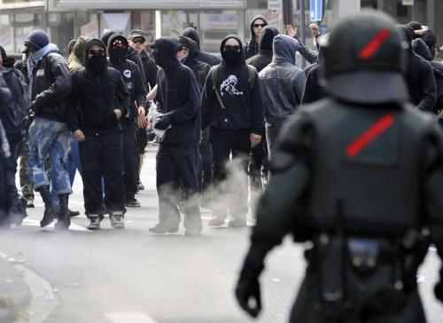

Slide 18
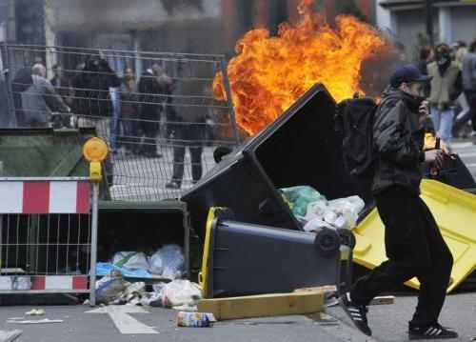

Slide 19
But passed on to another topic, I must say that in Germany the family has frequently been broken with the division of responsibilities between men and women. Men also cook, clean the house and take care of children. And what it is more interesting women in Germany often work in positions that in Poland are more often reserved for men, such as a bricklayer, truck driver, etc. I must say that in Germany, I liked the good condition of roads and a very clear and accurate road signs pointing the correct direction and I must say that it’s easier sometimes to move the car in a foreign country than in Poland. In addition, most Germans either by themselves or by hiring gardeners try to take care not only about their own homes, but also about the gardens the flowers, often cut the grass. The streets are very cleaned the roads often are planted with beautiful flowers. Here in Poland, some people care about it, others not because they don’t have enough time, money or no need. In general, staying in Germany I had the impression that they are mostly very pedantic, clean, tidy which sometimes annoyed me, because frankly I wouldn’t pay the attention to some trivia and certainly wouldn’t cut lawn in the garden every week. What’s interesting being in the vicinity of Luxembourg I was few times shopping in this country and thought that as I pass throught the German border on the other side of the border. I will be able to communicate in German, but it turned out differently. In response to my questions always heard the French language and eventually Englisch. It turns out that people in Luxembourg known the German language, but they don’t want to speak it, because at the time of World War II, Hitler had decided to join this country to Germany. He said that it is so tiny that it doesn’t even make sense to fight for it, he is simly a part of Germany and German language should be used. Overall, I must say that during my stay in Germany I came into contact with many people, some were friendly, cheeful, while others locked up in themselves, indifferent. However, I must say that knowing the German language I can work, live, communicate in this country, but foreigners often work in lower positions, are worse paid by the Germans. I have always treated my stay in Germany as an oppurtunity to earn a little more cash to pursue my dreams in my country to graduate in the future and to set up my own company in Poland.

